Slide 1
Social Media Fake News Detector Presented By: SUMIT SUMAN 1SI17CS117 UMANG GUPTA 1SI17CS124 VANSHIKA TYAGI 1SI17CS126
Department of Information Science and Engineering
Siddaganga Institute of Technology, Tumakuru
Mini Project Presentation
Under the guidance of
Ms Bhargavi K
Assistant Professor
Dept. of ISE, SIT, Tumakuru

Slide 2
Problem Statement
In recent years, due to the booming development of online social networks, fake news for various commercial and political purposes has been appearing in large numbers and widespread in the online world.
Social media posts tend to form biased opinions and spread fake news which might instigate people. The inability of people to create an internal filter against their own bias and question the credibility of the news source has caused false information to plague modern society and is slowly leading to a world with only polarizing opinions.
The extensive spread of fake news has the potential for extremely negative impacts on individuals and society. Fake news is intentionally written to mislead readers to believe false information, which makes it difficult to detect; therefore, there is a need to include auxiliary information, such as multiple reliable information sources, to help make a determination.

Slide 3
Introduction
Fake news is not new however it has become a hot topic in. Traditionally we got our news from trusted sources, journalists and media outlets that are required to follow strict codes of practice. However, the internet has enabled a whole new way to publish, share and consume information and news with very little regulation or editorial standards.
It provides a highly interconnected world-wide platform for everyone to spread information to millions of people in a matter of few minutes, at little to no cost. While it has led to ground-breaking phenomenon such as real-time citizen journalism, at the same time it has led to increased visibility and impact of both true and false information. Recent surveys have alarmingly shown that people increasingly get their news from social media than from traditional news sources.
Many people now get news from social media sites and networks and often it can be difficult to tell whether stories are credible or not. Information overload and a general lack of understanding about how the internet works by people has also contributed to an increase in fake news or hoax stories. Social media sites can play a big part in increasing the reach of these type of stories.
This epidemic is especially prominent in people who grew up before the information age of computers and have never had to question the credibility of news sources in the past. Social media algorithms are built for engagement and likes, not perspective, and we aim to fix that with this.

Slide 4
Motivation
In the 21st century, the impact of fake news has become too widespread. Fake news has grown from being sent via emails to attacking social media. Besides referring to made-up stories designed to deceive readers into clicking on links, maximizing traffic and profit, the term also refers to biased news which might instigate people and form wrong opinions.
What's wrong with fake news?
Fake news destroys a person's credibility.
Fake news can hurt people.
Real news benefits everyone .
For example : during the 2016 US elections, scientists reasoned that those who voted for Obama in 2012 would probably have voted for Clinton in 2016 unless something changed their minds. So they found a group of voters who voted for Obama in 2012. Of these Obama voters, only 77% of them voted for Clinton in 2016; 10% voted for Trump, and the others didn’t vote or voted for someone else. Upon talking to each of the voters, it was found that their votes were influenced by fake news spread over the internet especially on social media.
Therefore, there is a need to detect such false information on the social media, to help everyone make a just and unbiased determination.

Slide 5
Objectives
The Main Objective of this project is to build a browser extension that will be developed for social media platforms and integrated into it.
It will allows users to gain a broader perspective on news items and events and develop unbiased opinions.
It provides with a global point of view by extracting news articles and related information using entity extraction and sentiment analysis.
It will be able to detect fake and biased news, which is a classic text classification problem with a straight forward proposition.

Slide 6
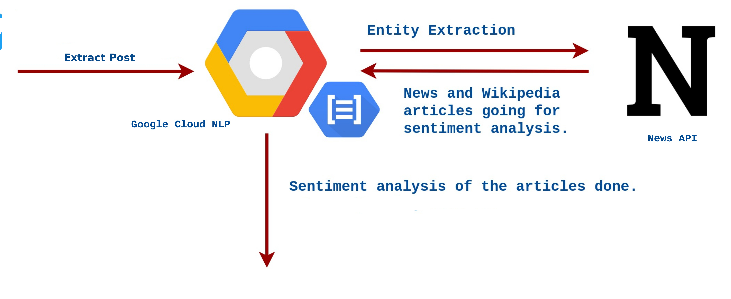
High Level Design
The browser extension will be integrated into the Social Media Platform UI. When clicked on, the extension will extract the entities and provide news articles related to that topic by making use of Social Media APIs and News APIs.
Natural Language Processing using machine learning toolkit performs entity extraction from social media posts to search for news articles from reliable sources.
Python client libraries are used to make calls to the Natural Language API. After the entity extraction, sentiment analysis is performed on the information obtained to select articles which have a different perspective from the social media post.
This helps the users broaden their perspective and understand the proper context and verify by themselves what is right and what is wrong.

Slide 7
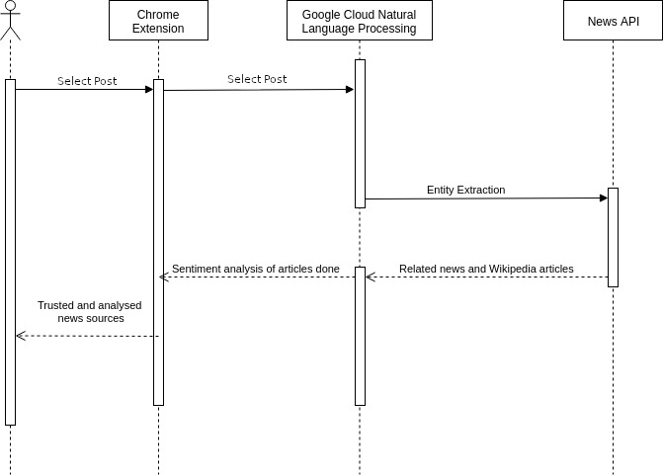

Slide 8
Tools And Platform
Chrome Extension: To scrape social media posts.
Social Media Website API : To give user option to select a post.
News API: To provide news articles related to post.
Google Natural Language API: For sentiment analysis and Natural Language processing.
Machine Learning Algorithms
Python
Flask
JavaScript
CSS
HTML

Slide 9
Expected Outcomes
This project is for the betterment of the society. People nowadays spend more time on social media which is heavily biased and based on false news. This extension will provide them with various news articles and Wikipedia articles to broaden their perspective and understand the proper context and verify by themselves what is right and what is wrong.
It will help them become more aware of news that is intentionally written to mislead readers to believe false information.
It will include multiple reliable information sources with respect to the news, to help the user make a unbiased opinion.

